Slide 1
Webinar on traceability of digital sequence information on genetic resources (DSI)
Global Webinar
2nd November 2021, 13:00-15:00 CET

Slide 2
Welcome remarks
The ABS Initiative announces the continuation of its activities on DSI in the context of the Norwegian – South African Environmental Cooperation Program
First round of publications, webinars and the Global Dialogue on DSI brought together many governmental experts and negotiators, stakeholders from various sectors and representatives of indigenous peoples and local communities
Support for an informed exchange on DSI during OEWG 3.1 in the context of the future post-2020 Global Biodiversity Framework
A formal intersessional process asking for submissions on DSI and for further analyses of the policy approaches, options and modalities will prepare for OEWG 3.2
As contribution to the informal intersessional process, the ABS Initiative will concentrate on remaining divergences in the DSI discussion, based on the analysis of the Co-Leads of the contact group on DSI of the OEWG
https://www.cbd.int/meetings/WG2020-03

Slide 3
Agenda
Welcome |  | ABS Initiative
Rationale for a discussion on traceability of the use of DSI
 | Overview about the use of DSI and the discussion on traceability | Hartmut Meyer
 | Where are we in the DSI process? | Secretariat of the CBD
 | Traceability options for genetic resource and associated sequence information to enable benefit sharing | Fran Humphries
Expert round with Q&A – moderated by the co-leads of the DSI contact group at OEWG 3 (Lactitia Tshitwamulomoni, ZA & Gaute Voigt-Hanssen, NO)
 | Queensland University of Technology, Australia | Fran Humphries
 | University of Aberdeen, UK | Marcel Jaspars
 | University of Lethbridge, Canada | Florian Rohden
 | Third World Network, USA | Edward Hammond
 | International Lifestock Research Institute, Kenya | Christian Tiambo
Closing remarks, take home messages (ABS Initiative)

Slide 4
Webinar on traceability of digital sequence information on genetic resources (DSI)
Global Webinar
2nd November 2021, 13:00-15:00 CET
Dr. Hartmut Meyer, Team Leader
ABS Capacity Development Initiative

Slide 5
















DSI – Third Party (Commercial) Use – Traceability
Genetic
resource
Agreement
“PIC”
ABS-contract
“MAT”
Research, development
& products by third parties
Databank
Global access
Commercial use
DNA / RNA
-G-A-C-T-A-G-
Access to
MANY accessions
by one user
Protein
-LEU-ILE-
Non-commercial
use
Benefit sharing
Country of
origin
Benefit sharing

Slide 6
Views on DSI traceability in the post-2020 process
Outcome of the AHTEG on DSI
“It was noted that traceability could be more or less relevant depending on the approach to benefit sharing followed, and the related monitoring and compliance requirements. For example, in the case of a multilateral approach to benefit-sharing, traceability of digital sequence information to the provider countries and monitoring its use along the value chain may not be required.”
Discussions during Global DSI Dialogue and OEWG 3
Traceability necessary to bring back benefits to the providers of GR / DSI
Traceability is linked to the bilateral approach of the Nagoya Protocol
Current pattern of DSI use makes tracking and tracing very difficult / ineffective
Costs of traceability system might exceed the benefits created / shared significantly
Multilateral approaches for DSI benefit sharing can work without traceability

Slide 7

Traceability Options for Genetic Resource and Associated Sequence Information to enable Benefit Sharing
Fran Humphries, Queensland University of Technology, Australia
Marcel Jaspars, University of Aberdeen, UK
Muriel Rabone, Natural History Museum, UK

Slide 8
Overview
1. Abyssine – an example of a commercial product based on marine genetic resources (MGR)
2. Traceability Policy Options and Implications for DSI
  Track and trace versus traceability approaches
  Track and trace options
  Contractual/licensing traceability options
  End-product/end-user traceability options
  Existing open-access traceability options
  Combined traceability approaches
  Carrot options for traceability
3. Conclusions

Slide 9
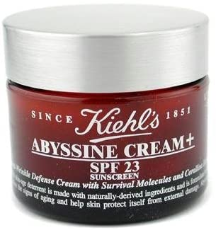
Abyssine (Deepsane)
Commercial – Abyssine®
Developed by Lanatech then sold by Lucas Meyers
Lucas Meyers merged with UNIPEX
(Cosmetic Ingredients)
In Kiehl’s Abyssine Cream(?)
Kiehl’s bought by L’Oreal
Soothing and reducing irritation of sensitive skin against chemical, mechanical and ultraviolet B (UVB) aggression
1987 (French Hydronaut cruise)
Hydrothermal vent located on the East Pacific Rise at 2625 m depth
12º48.56’ N, 103º56.72’ W
Polychaete annelid
Alvinella pompejana
Activity 2002
2002 Publication
Bacterial strain HYD657
Alteromonas macleodii
subsp. fijiensis biovar deepsane
(IFREMER)
EPS HYD657
1993
Patent Priority Date
2002
US Patent Granted
Strain deposit under
Budapest Treaty (CNCM)
DSI 2001 GenBank: AJ319537.1
Alteromonas macleodii subsp. abyssi
16S rRNA gene, strain HYD657
Structure 2012
Checked by IFREMER

Slide 10
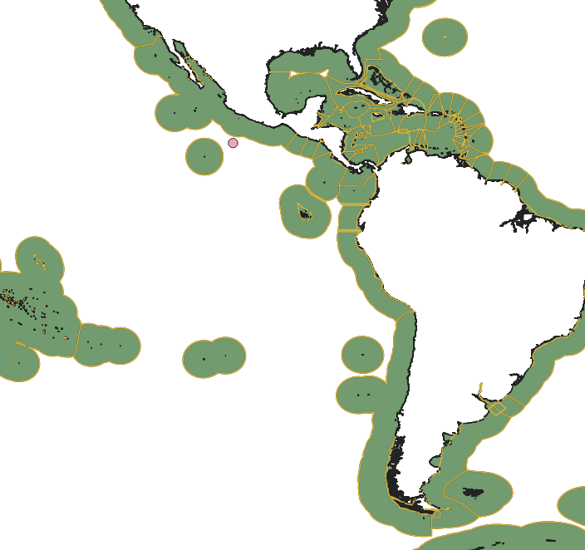
Why this case study?

Slide 11
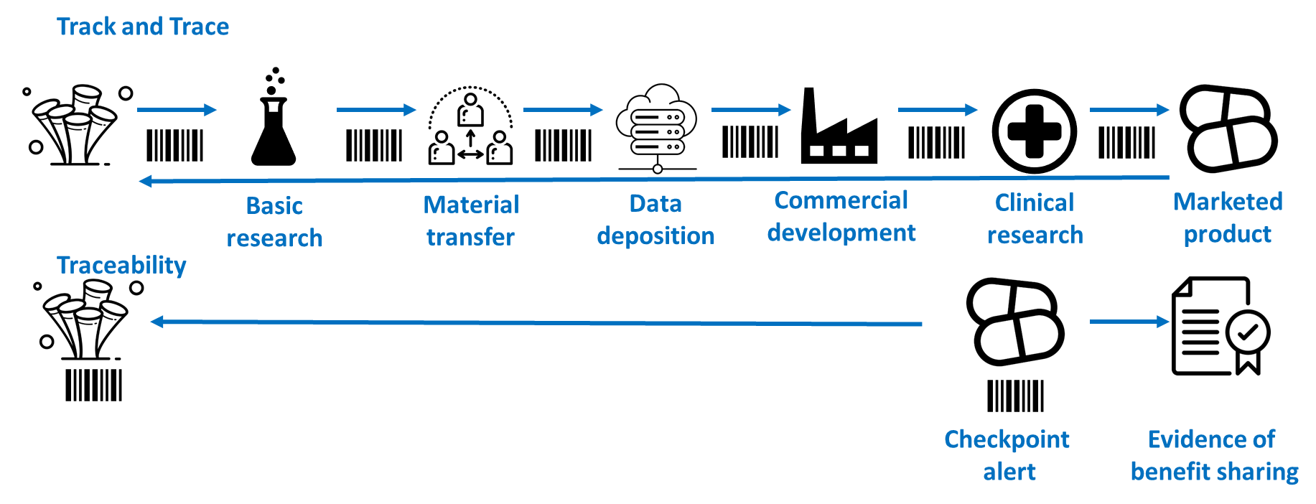
Comparing Track & Trace with Traceability

Slide 12
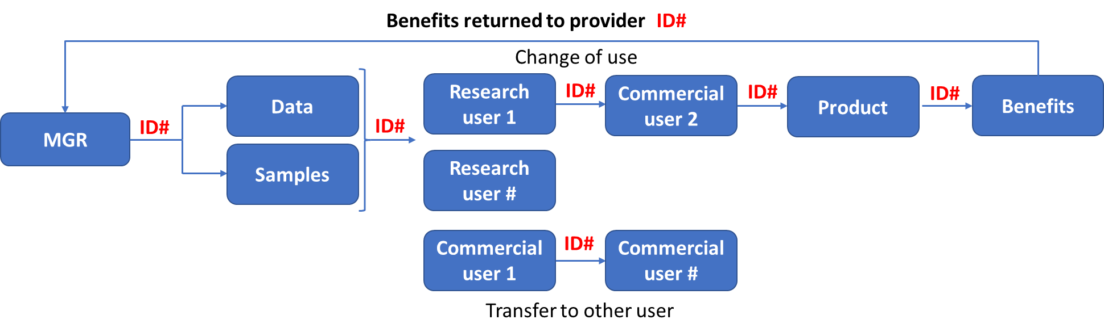
Track & Trace Identifier Option
Administrative steps in red
ID# = scientific and/or administrative identifier

Slide 13
Track & Trace Identifier Option
Challenges:
Opportunities:
Tracing information independently of the physical sample;
Gaps and variability in monitoring mechanisms;
Compliance burden placed on initial researchers not end-users;
Systems likely to be high cost.
Linking with existing compliance measures under national law e.g. reporting, checkpoints, change of use, third party transfer provisions…

Slide 14
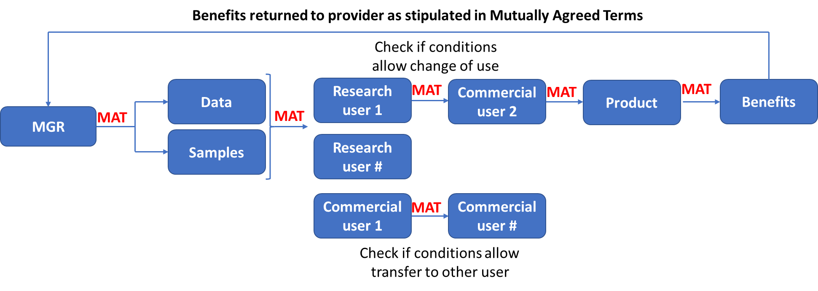
Contractual/Licensing Traceability Option
Administrative steps in red

Slide 15
Contractual/Licensing Option
Opportunities:
Challenges:
SMTAs can reduce compliance burden by providing standard terms and conditions;
SMTAs can be made machine readable aiding traceability;
Machine readable creative commons licences could be used for DSI.
Countries have not agreed on standard conditions under a multilateral system that are consistent across countries;
Third party transfer often precluded, increasing burden on researchers to negotiate this on a case-by-case basis.

Slide 16
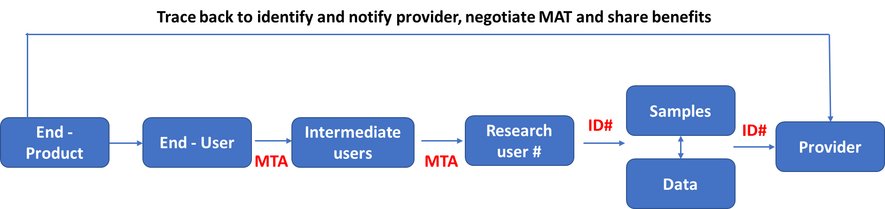
End-User/End-Product Traceability Option
Administrative steps in red

Slide 17
End-User/product Option
Opportunities:
Challenges:
Lower impact on research - obligations for reporting and benefit sharing are only triggered once economic exploitation arises linking end user to provider through various databases (e.g. INSCD, Patent databases).
Resources and infrastructure required to link end-use to original data and/or sample;
Higher reliance on good-faith of end-users and accurate/public records of movements and uses.

Slide 18
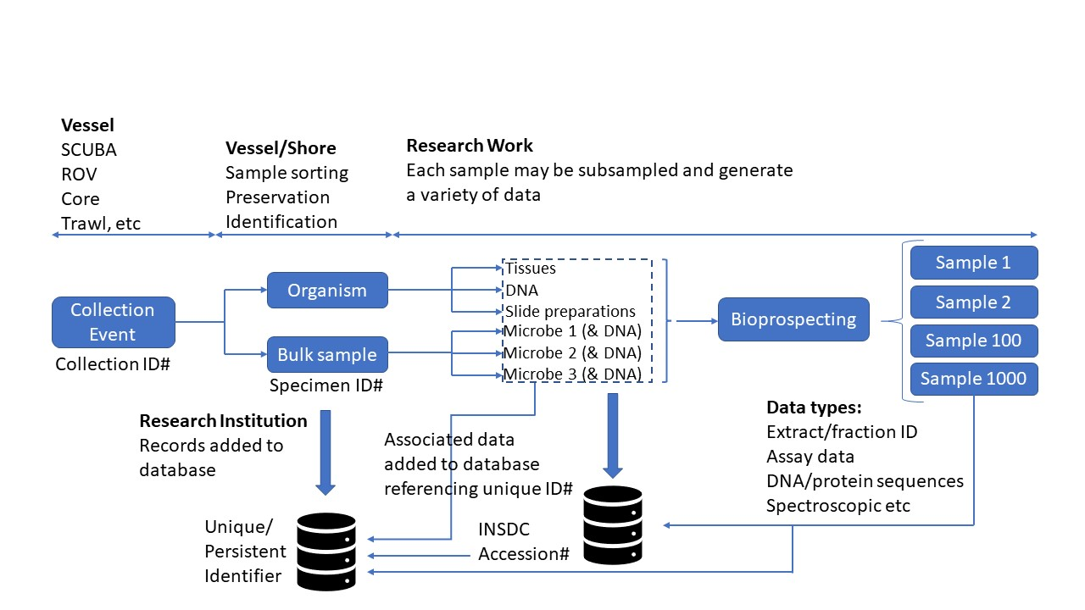
Open Access & Traceability

Slide 19
Open Access Considerations
Opportunities:
Challenges:
Not all collections are globally discoverable or accessible;
Better linkages between databases required;
Relies on databases and repositories receiving long term funding.
Builds on good scientific practice and existing databases/repositories;
Research norms encourage compliance.

Slide 20
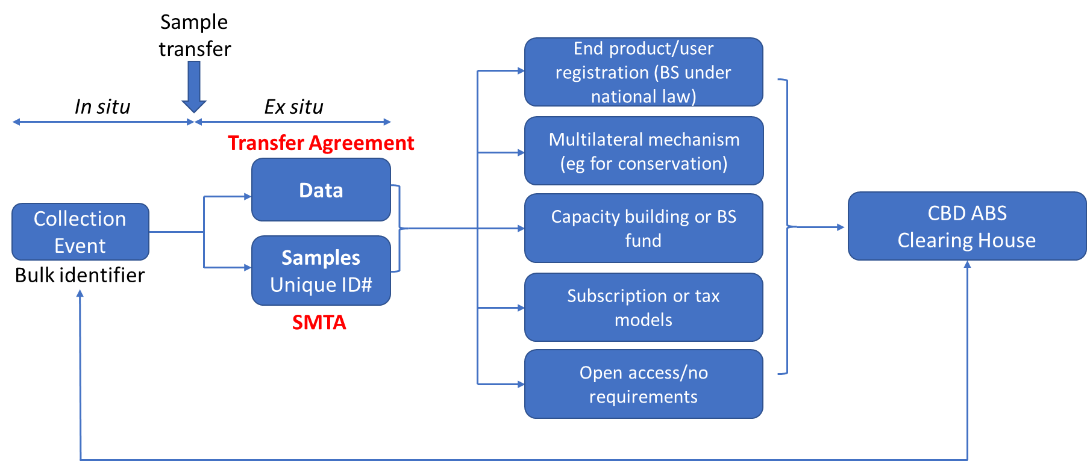
Combined Approaches to Traceability
Administrative steps in red

Slide 21
Combined Approaches to Traceability
Opportunities:
Challenges:
Builds on good scientific practice and uses some existing databases/repositories;
Flexibility for choosing possible options.
Includes some of the challenges for traceability options above;
Would need to be designed from scratch.

Slide 22
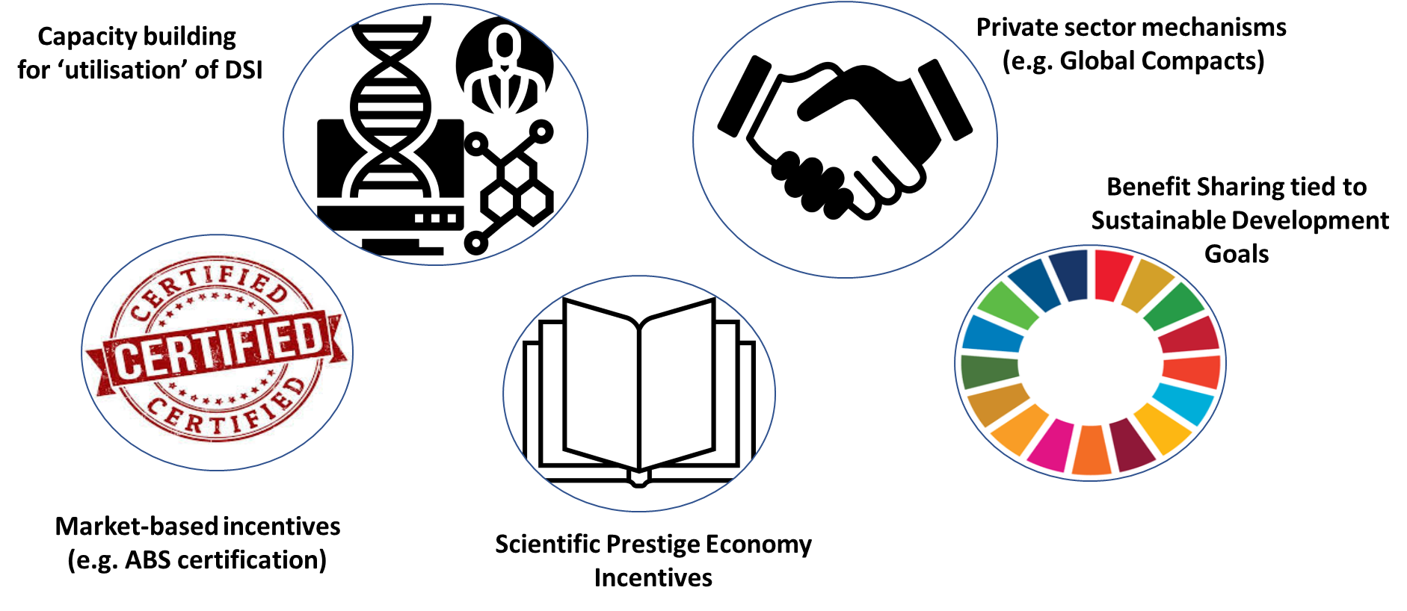

Carrot Options for Tracing DSI

Slide 23
Conclusions
Traceability for the DSI/CBD debate needs to be considered within the broader context - geographical, subject matter, activity and temporal scope of the various ABS frameworks;
There need not be a one-size-fits all approach to traceability mechanisms;
Diverse approaches which suit local research and development environments can achieve similar traceability outcomes;
Considerations need to be made in each country regarding potential impact of systems developed on basic research, practicality for achieving traceability objectives and resourcing implications;
Approaches likely to be successful should build on existing global infrastructure, or use procedures developed in other policy instruments.

Slide 24
References
Fran Humphries, Muriel Rabone & Marcel Jaspars (2021) ‘Traceability Approaches for Marine Genetic Resources under the proposed Ocean (BBNJ) Treaty’ 8 Frontiers in Marine Science 430 https://doi.org/10.3389/fmars.2021.661313
Marcel Jaspars, Fran Humphries & Muriel Rabone (2021) Tracing Options for Marine Genetic Resources from within National Jurisdictions, Advisory Note, Commonwealth Secretariat: London, Marlborough House, July 2021
Fran Humphries, Hiroko Muraki Gottlieb, Sarah Laird, Rachel Wynberg, Charles Lawson, Michelle Rourke, Morten Walløe Tvedt, Maria Julia Olivia & Marcel Jaspars (2020) ‘A Tiered Approach to the Marine Genetic Resource Governance Framework under the proposed UNCLOS Agreement for Biodiversity beyond National Jurisdiction (BBNJ)’ 122 Marine Policy https://doi.org/10.1016/j.marpol.2020.103910
Broggiato, A., Vanagt, T., Lallier, L. E., Jaspars, M., Burton, G., and Muyldermans, D. (2018). ‘Mare geneticum: balancing governance of marine genetic resources in international waters’ 33 International Journal of Marine and Coastal Law 3–33. https://doi.org/10.1163/15718085-13310030

Slide 25
Closing remarks
Evaluation: before you leave, please help us improving our work and participate in the short evaluation of this webinar

Slide 26

Thank you!
Further information can be found on our website: www.abs-initiative.info
ABS Capacity Development Initiative
Division Climate Change, Environment & Infrastructure
GloBe - Department Sector and Global Programmes
Deutsche Gesellschaft für
Internationale Zusammenarbeit (GIZ) GmbH
Postfach /P.O. Box 5180
65726 Eschborn
Germany

